Slide 1
EAv2
Spatio-temporal analysis for EAv2 release 1 dataset
Pers and Timshel

Slide 2
Input – SNPs and Gene lists
GWAS significance level | P < 1e-05
Number of input SNPs | 178 SNPs (after DEPICT clumping)
Number of input loci | 178
Gene list | Number of genes | Remark
Prioritized | 84 | Only nominal significant (P < 0.05). No genes significant based on FDR
Associated | 291
Nearest | 178

Slide 3
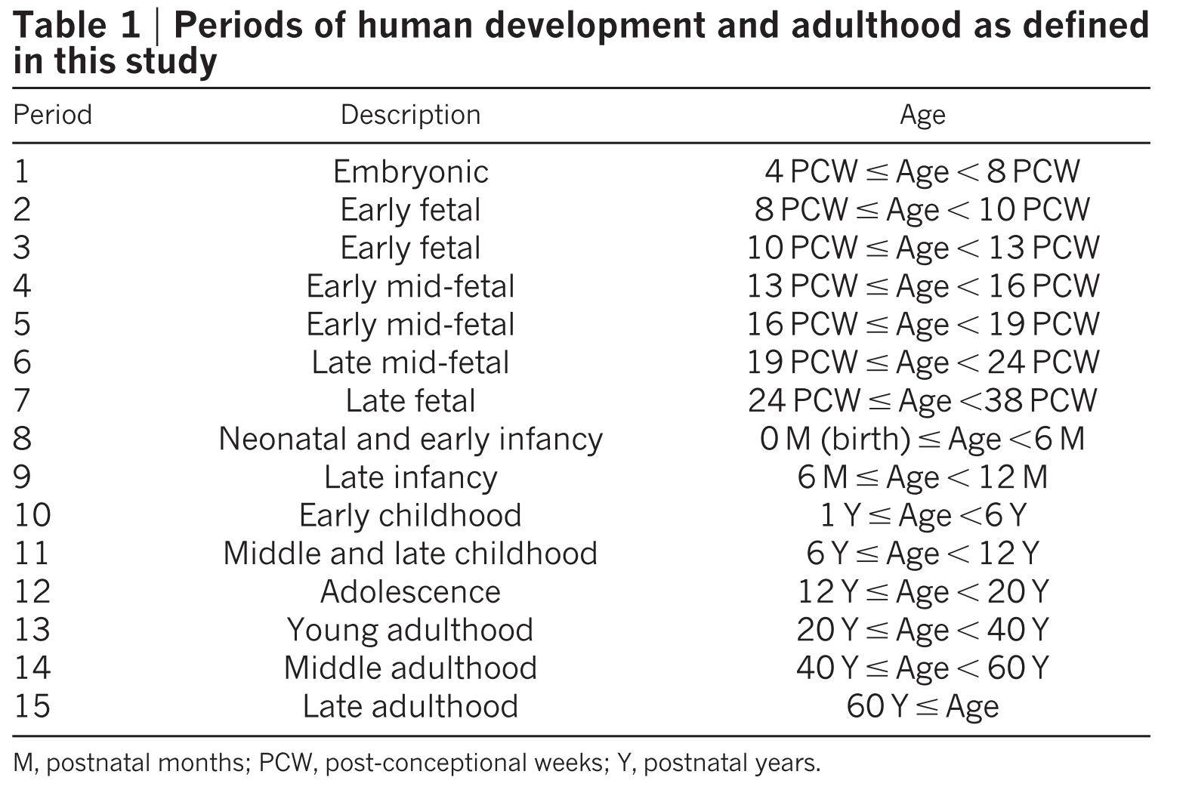
BrainSpan Developing Brain Transcriptome
Kang et al. Nature 2011
RNA-Seq expression data
524 RNA-Seq samples
26 structures
17 time points: Early fetal development to middle adulthood
Notes:
492 microarray samples

Slide 4
Time Series plot 1

Slide 5
Statistics: prenatal vs postnatal
> fit1 <- t.test(mean~natal, data=df.natal.gene.mean, alternative="less", paired=TRUE) # OBS: EAv2 is testing "less" (SCZ was testing alternative="greater")
> fit1
Paired t-test
data: mean by natal
t = -3.1723, df = 83, p-value = 0.00106
alternative hypothesis: true difference in means is less than 0
95 percent confidence interval:
-Inf -0.1574609
sample estimates:
mean of the differences
-0.3310444
> fit1$p.value
[1] 0.001060153
> ### calculation odd's ratio
> df.or <- ddply(df.natal.gene.mean, .(natal), summarise,
+ group_mean=mean(mean, na.rm=T))
> df.or
natal group_mean
1 postnatal 2.773967
2 prenatal 3.105011
> or_log2_corrected <- (2^df.or[df.or$natal=="prenatal","group_mean"]-1)/(2^df.or[df.or$natal=="postnatal","group_mean"]-1)
> #formula: or = ((2^mu1)-1)/((2^mu2)-1)
> or_log2_corrected
[1] 1.30209

Slide 6
Identifing most highly expressed stage
stage mean_stage sd_stage
4 s3b 3.254827 1.556582
5 s4 3.170036 1.557318
2 s2b 3.155874 1.618078
3 s3a 3.146092 1.600446
7 s6 2.966788 1.479473
1 s2a 2.948113 1.563771
12 s11 2.903698 1.533366
11 s10 2.851212 1.498817
10 s9 2.764652 1.523281
8 s7 2.729605 1.527834
6 s5 2.717927 1.465799
9 s8 2.446929 1.443785
testing for difference to other stages
stage V1
2 s2b 0.034518816
3 s3a 0.007785642

Slide 7
prioritized_genes_structure=FC_with_mean-20x20.pdf

